Slide 1
Curriculum in Mathematics
By Dr. Meena Sharma

Slide 2
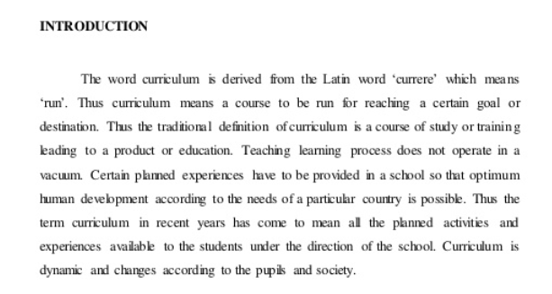
Introduction
Details

Slide 4
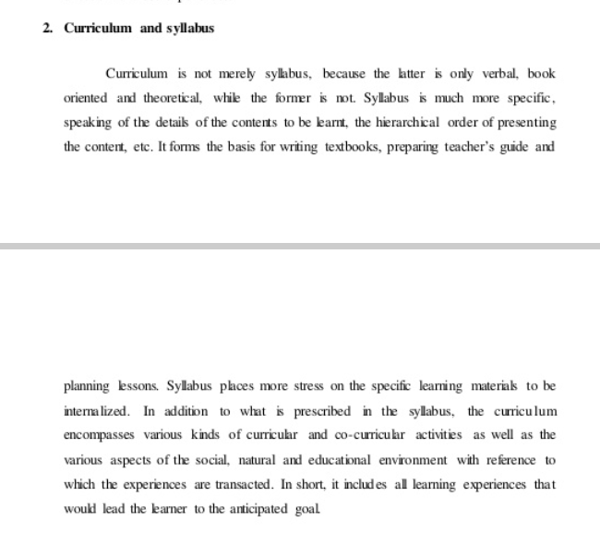
Curriculum and Syllabus
Details

Slide 6
Principles of Curriculum Construction

Slide 12
Details

